Slide 1
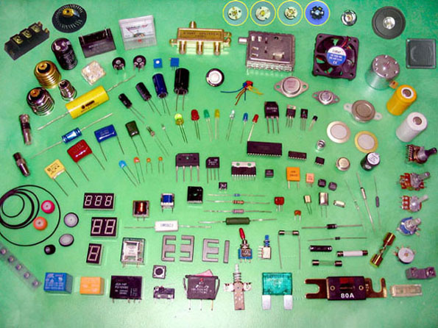

Arduino Lab

Slide 2
About the Lab
Take what we did last semester, and add a computer to the circuit
  Same tools and components, plus an Arduino
  Lab will focus on the software that controls the hardware
YOU will be designing the software
Equally applicable to EE and CPE
I’ll provide everything except an Arduino (with the exception of loaners)
Bring your laptop!

Slide 3
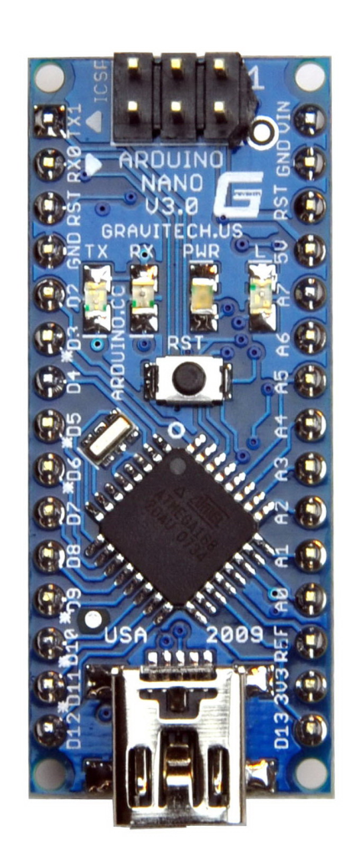
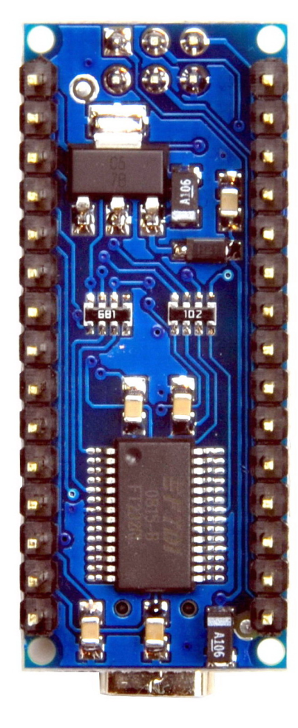
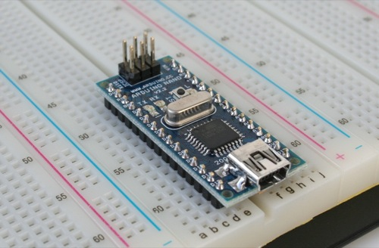
Arduino Nano
Specifications:
Microcontroller- Atmel ATmega328
Operating Voltage- 5 V
Digital I/O Pins- 14 (6 provide PWM output)
Analog Input Pins- 8
DC Current per I/O Pin- 40 mA
Flash Memory- 32 KB
Clock Speed- 16 MHz
Dimensions- 0.70” x 1.70”
Why Nano?
Breadboard-able
Mini-USB cable
Tiny

Slide 4
Example Projects
http://www.youtube.com/watch?v=FCRbkroobXM&feature=related
http://www.youtube.com/watch?v=Qlukl5fLi7s&feature=related

Slide 5
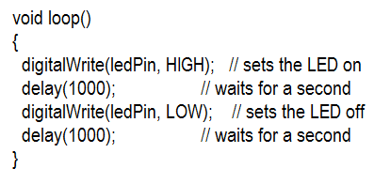
Arduino Code
C++ with Arduino related functions
Very simple to write
Tons of online code and references
Example

